Slide 1



Breast Ultrasound Image Segmentation & Classification
By Abtahi Bin Jahangir Chowdhury
(Image Processing)

Slide 2
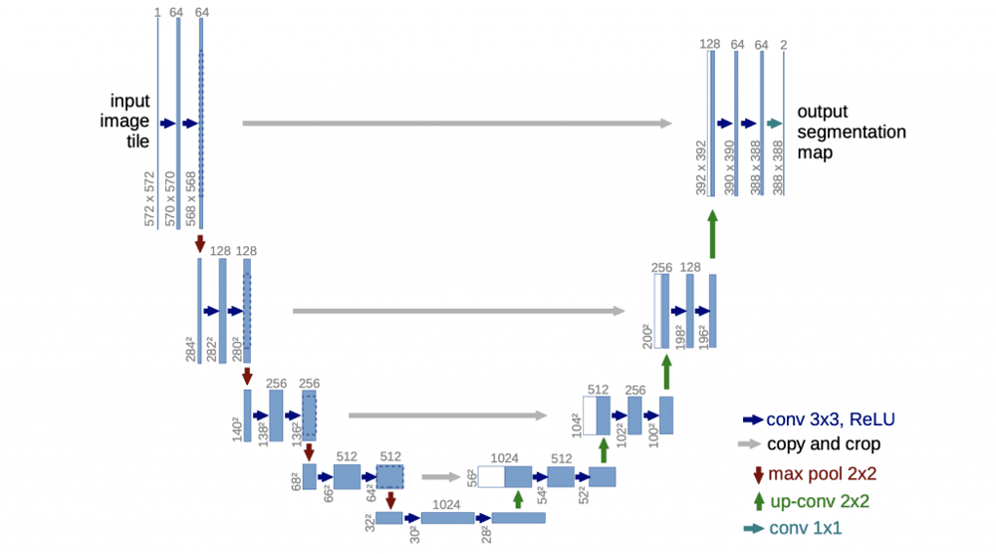
Multi‑Task U-Net Architecture
Shared Encoder:
  4 convolutional blocks (64→128→256→512 filters)
  Each block: 2 × 3×3 Conv (ReLU) + Dropout (0.1) + 2×2 Max-Pooling
  Extracts hierarchical features, reducing spatial size while increasing depth (bottleneck)
Segmentation Decoder:
  Mirror of encoder with ConvTranspose layers for upsampling
  Skip Connections to preserve spatial detail
  Final 1×1 Conv (Sigmoid) for binary mask (128×128)
Classification Head:
  Global Average Pooling on bottleneck (512 filters at 8×8)
  Dense (128 units, ReLU) + Dropout (0.3)
  Dense (3 units, Softmax) for Normal, Benign, Malignant prediction
Why Multi-Task?
  Shared encoder reduces parameters, improves feature learning
  Joint learning enhances both segmentation and classification by aligning feature importance

Slide 3
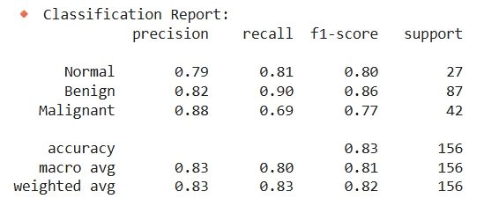
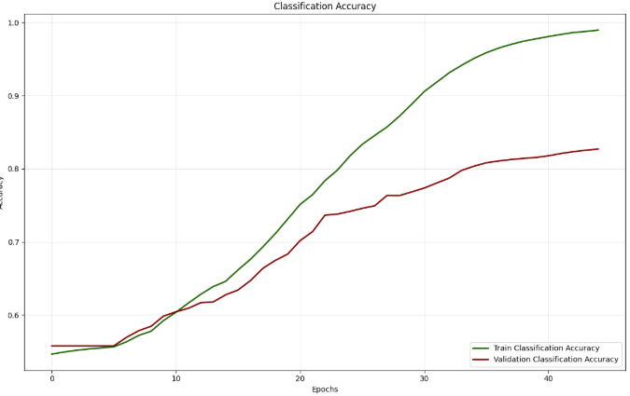
Quantitative Results
Mean IoU
~0.83 on training vs 0.75 on validation (75% overlap).
Pixel Accuracy
97.4% (train) vs 95.8% (val)
Dice Coefficient
~0.85–0.90 (train) vs 0.705 (val). In validation, on average ~70.5% Dice

Slide 4
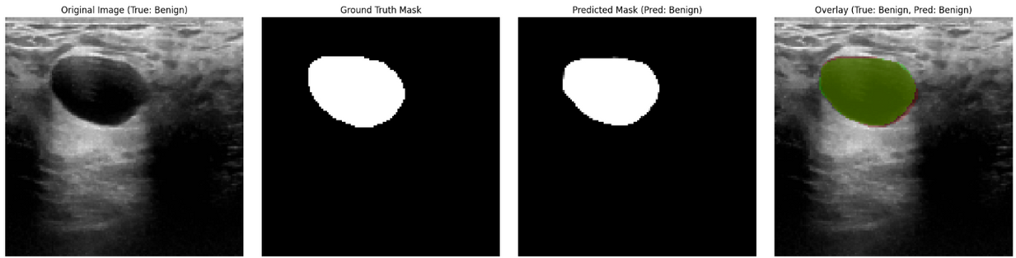
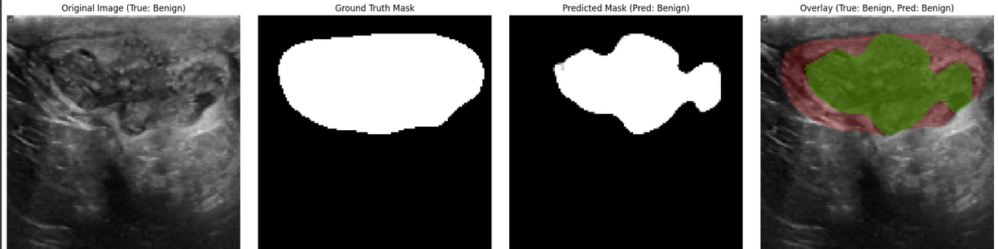
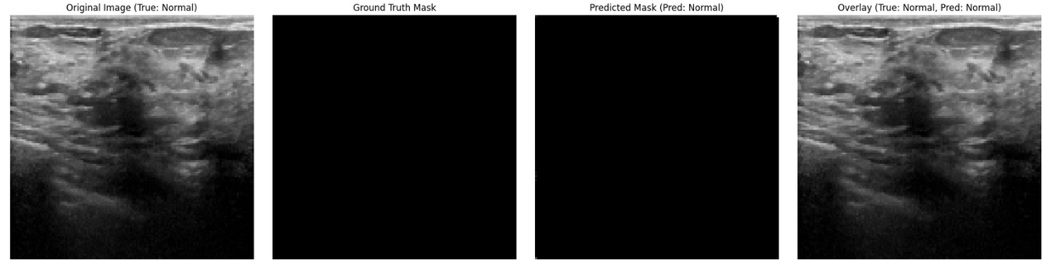
Qualitative Results (High Quality)

Slide 5
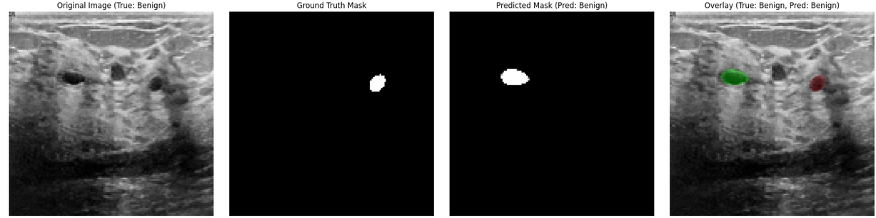
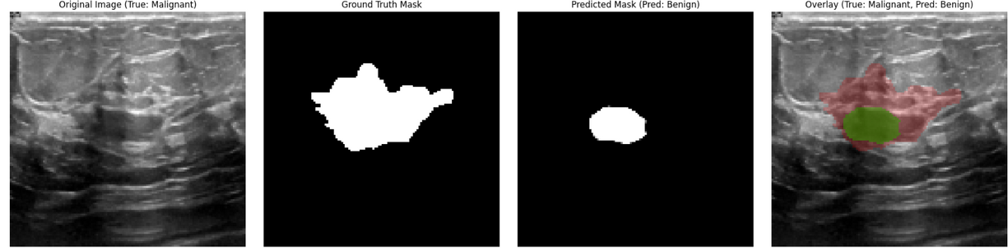
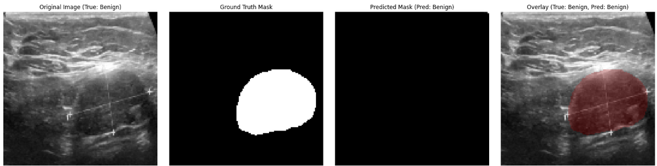
Qualitative Results(Challenging)

Slide 6

Thank You!

